Slide 1
4CS015 Lecture 3: Combinational Circuit

Slide 2
1. Lecture 3 coverage
Review of Week 2
Boolean gates and logic
Mathematical functions in logic!
Understanding addition
Making our own truth tables
Building a circuit that can perform maths
Reducing logic
1. Lecture 3 coverage

Slide 3
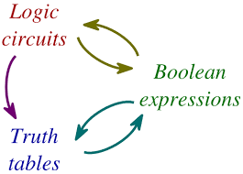
2. Boolean Expression Reduction
2. Boolean Expression Reduction
2.1. Boolean Expression
from Truth table
2.1.1. SOP Expression from
Truth table
2.1.2. SOP Expression from
Truth table

Slide 4
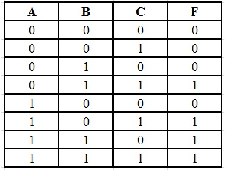
2.1. Boolean Expression from Truth table
How do we derive Boolean Expression from the given Truth Table??
SUM OF PRODUCT
SOP Expression:
F = A’BC + AB’C + ABC’+ABC
PRODUCT OF SUM
POS Expression:
F = (A + B + C) (A + B + C ‘) (A + B’ + C) (A’ + B + C)
2. Boolean Expression Reduction
2.1. Boolean Expression
from Truth table
2.1.1. SOP Expression from
Truth table
2.1.2. SOP Expression from
Truth table
How do we know?? Well we will know that today.

Slide 5
2.1.1. SOP Expression from Truth table
SUM OF PRODUCT
Scan for 1 in output variable (F)
Scan its corresponding input variable,
Here, A = 0 , B = 1 and C= 1
If input is “1” write the variable as it is and if the variable is “0” then complement the variable. AND the variable together.
The first expression is A’.B.C
Do likewise for all the remaining output then OR the AND terms to obtain the output function.
F = A’BC + AB’C + ABC’+ABC
2. Boolean Expression Reduction
2.1. Boolean Expression
from Truth table
2.1.1. SOP Expression from
Truth table
2.1.2. SOP Expression from
Truth table

Slide 6
2.1.2. POS Expression from Truth table
PRODUCT OF SUM
Scan for 0 in output variable (F)
Scan its corresponding input variable,
Here, A = 0 , B = 0 and C= 0
If input is “0” write the variable as it is and if the variable is “1” then complement the variable. OR the variable together.
The first expression is A+B+C
Do likewise for all the remaining output then AND the Or terms to obtain the output function.
F = (A + B + C) (A + B + C ‘) (A + B’ + C) (A’ + B + C)
2. Boolean Expression Reduction
2.1. Boolean Expression
from Truth table
2.1.1. SOP Expression from
Truth table
2.1.2. POS Expression from
Truth table

Slide 7
3. Circuit Design
Three Steps starting from given circuit requirements in the form of a table.
Formulate a Boolean expression for the output function from the given table Using SOP or POS expression.
Simplify this expression as much as possible using Boolean algebra.
Draw the circuit corresponding to the simplified output function.
3. Circuit Design (Contd.):

Slide 8
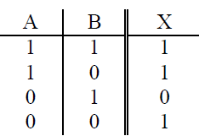
3. Circuit Design (Contd.):
Example:
We will design a circuit corresponding to the following truth table. The output function is labelled X.
3. Circuit Design (Contd.):

Slide 9
3. Circuit Design (Contd.):
Step 1. First scan the output column for occurrences of 1. In this example there are three (lines 1, 2 and 4).
For each of these lines construct a sub-expression involving A and B and the operations AND (⋅) and NOT ( ͞ ) only that will return the value 1 for the corresponding input values.
In row 1, A = 1 and B = 1 so A ⋅ B will return the value 1 for these input values and for no others.
3. Circuit Design (Contd.):

Slide 10


3. Circuit Design (Contd.):
In row 2, A = 1 and B = 0 so A ⋅ B will return the required 1 for these values
3. Circuit Design (Contd.):
Finally, with A = 0 and B = 0, row 4 will require A ⋅ B
The three expression obtained are then combined together using OR (+) operations. The final expression

Slide 11

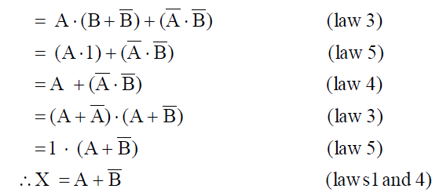
3. Circuit Design (Contd.):
Step 2: Simplify the Boolean Expression.
3. Circuit Design (Contd.):

Slide 12
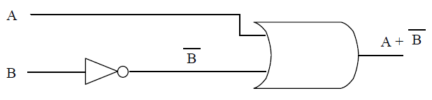
3. Circuit Design (Contd.):
Step 3: The circuit for the simplified output function X requires
only two gates:
3. Circuit Design (Contd.):
Check that the truth table for X = A + B agrees with the original.
The method extends easily to three or more input pulses.

Slide 13
3. Circuit Design (Contd.):
Another Example:
Design a Circuit corresponding to:
3. Circuit Design (Contd.):
A | B | C | X
1 | 1 | 1 | 1
1 | 1 | 0 | 0
1 | 0 | 1 | 1
1 | 0 | 0 | 0
0 | 1 | 1 | 1
0 | 1 | 0 | 0
0 | 0 | 1 | 0
0 | 0 | 0 | 0

Slide 14
3. Circuit Design (Contd.):
Step 1 There is a 1 in lines 1, 3 and 5 of the output column.
3. Circuit Design (Contd.):
The sub-expressions which will return 1 in these lines are, respectively
A ⋅ B ⋅ C, A ⋅ B ⋅ C and A ⋅ B ⋅ C
The Boolean Expression is therefore given by
X = (A ⋅ B ⋅ C) + (A ⋅ B ⋅ C) + (A ⋅ B ⋅C)

Slide 15
3. Circuit Design (Contd.):
Step 2 : Simplify
X = (A ⋅ B ⋅ C) + (A ⋅ B ⋅ C) + (A ⋅ B ⋅ C)
3. Circuit Design (Contd.):
X = (A ⋅ B ⋅ C) + (A ⋅ B ⋅ C) + (A ⋅ B ⋅ C)
X = A.C (B + B ) + (A ⋅ B ⋅ C)
X = A.C .1 + (A ⋅ B ⋅ C) (Complement law)
X = A.C + (A ⋅ B ⋅ C)
X = C . ( A + A . B)
X = C . (A + B) (Distributive law)
The simplified Boolean Expression is therefore given by
X = C . (A + B)

Slide 16
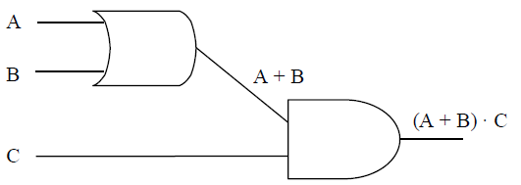
3. Circuit Design (Contd.):
Step 3 The circuit for (A + B) ⋅ C is
3. Circuit Design (Contd.):

Slide 17
4. Exercises ……
1.Design a Circuit corresponding to following truth tables:
A | B | C | X
1 | 1 | 1 | 0
1 | 1 | 0 | 0
1 | 0 | 1 | 0
1 | 0 | 0 | 0
0 | 1 | 1 | 1
0 | 1 | 0 | 1
0 | 0 | 1 | 1
0 | 0 | 0 | 0
A | B | C | X
1 | 1 | 1 | 1
1 | 1 | 0 | 0
1 | 0 | 1 | 1
1 | 0 | 0 | 0
0 | 1 | 1 | 1
0 | 1 | 0 | 0
0 | 0 | 1 | 1
0 | 0 | 0 | 1
4. Exercises ……

Slide 18
4. Exercises ……
Simplify and construct the logic circuit:
A’.B’ + (A.B)’
(A + B).(A + B) + A.(A + B’)
(A’. B + A.B’)’
((A + C).(AB)’ + (BC + A’)’)’
(A.B’.C’ + A’.B’.C+A.B.C+A’.B.C’)
4. Exercises ……

Slide 19
5. Addition Rules as a Table
Number 1 and Number 2 are the Inputs.
Sum and Carry are the results after addition.
5. Addition Rules as a Table
Number 1 | Number 2 | Result | Carry Over
0 | 0 | 0 | 0
0 | 1 | 1 | 0
1 | 0 | 1 | 0
1 | 1 | 0 | 1

Slide 20

6. Addition as Logical Functions
Input A Number 1 | Input B Number 2 | Sum | Carry
0 | 0 | 0 | 0
0 | 1 | 1 | 0
1 | 0 | 1 | 0
1 | 1 | 0 | 1
6. Addition as Logical Functions
Assume that SUM is now a truth table Entry then:
Doing the same for CARRY we get:

Slide 21
7. Half Adder
Combinational logic circuits give us many useful devices.
One of the simplest is the half adder, which finds the sum of two bits.
We can gain some insight as to the construction of a half adder by looking at its truth table, shown at the right.
7. Half Adder

Slide 22
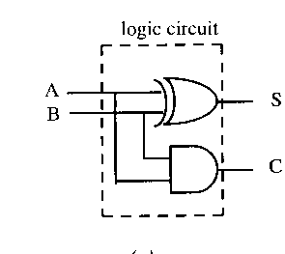
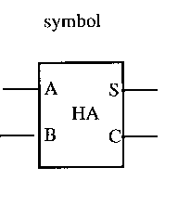
7. Half Adder
7. Half Adder
Input A | Input B | S (Sum) | C (Carry)
0 | 0 | 0 | 0
0 | 1 | 1 | 0
1 | 0 | 1 | 0
1 | 1 | 0 | 1

Slide 23
8. Full Adder function
Input A | Input B | Carry IN | Sum | Carry OUT
0 | 0 | 0 | 0 | 0
1 | 0 | 0 | 1 | 0
0 | 1 | 0 | 1 | 0
1 | 1 | 0 | 0 | 1
0 | 0 | 1 | 1 | 0
1 | 0 | 1 | 0 | 1
0 | 1 | 1 | 0 | 1
1 | 1 | 1 | 1 | 1
8. Full Adder Function
8.1 Full Adder
8.2 Full Adder from Two Half
Adders
8.3 Symbol for a Full Adder

Slide 24
8.1 Full Adder
We could derive the full Boolean expression for the Sum and Carry OUT.
However, there is a great deal of symmetry associated with the half and full adder and we can simply build a FULL from two Halves.
8. Full Adder Function
8.1 Full Adder
8.2 Full Adder from Two Half
Adders
8.3 Symbol for a Full Adder

Slide 25
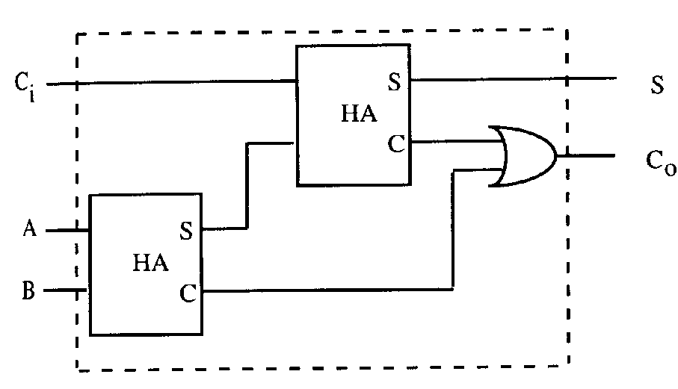
8.2 Full Adder from Two Half Adders
The Full Adder:
8. Full Adder Function
8.1 Full Adder
8.2 Full Adder from Two Half
Adders
8.3 Symbol for a Full Adder
The Half Adder
 |  | 1 | 1 | 0
+ |  | 1 | 1 | 1
carry: | 1 | 1 | 0
 | 1 | 1 | 0 | 1

Slide 26
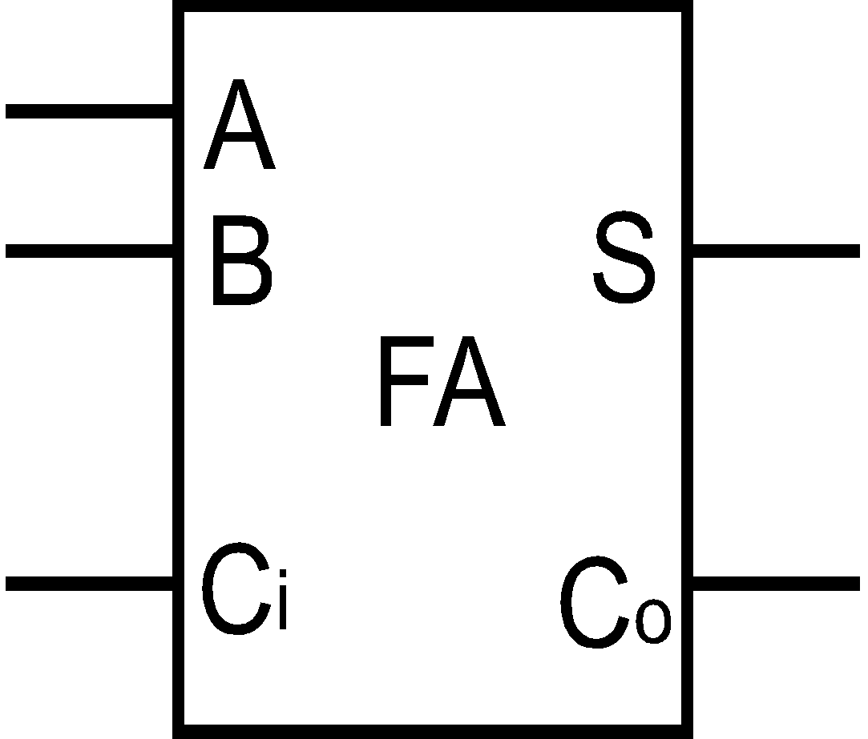
8.3 Symbol for a Full Adder
A | B | C_{in} | S | C_{out}
0 | 0 | 0 | 0 | 0
1 | 0 | 0 | 1 | 0
0 | 1 | 0 | 1 | 0
1 | 1 | 0 | 0 | 1
0 | 0 | 1 | 1 | 0
1 | 0 | 1 | 0 | 1
0 | 1 | 1 | 0 | 1
1 | 1 | 1 | 1 | 1
8. Full Adder Function
8.1 Full Adder
8.2 Full Adder from Two Half
Adders
8.3 Symbol for a Full Adder

Slide 27
9. Reduction.
If you develop the sum of products for the full adder.
Sum = ABC+ABC+ABC+ABC
Carry OUT = ABC+ABC+ABC+ABC
These show very little resemblance to the circuits we are using.
By applying the laws and theorems of Boolean algebra we should be able to get from the above to our circuits.
A | B | C_{in} | S | C_{out}
0 | 0 | 0 | 0 | 0
1 | 0 | 0 | 1 | 0
0 | 1 | 0 | 1 | 0
1 | 1 | 0 | 0 | 1
0 | 0 | 1 | 1 | 0
1 | 0 | 1 | 0 | 1
0 | 1 | 1 | 0 | 1
1 | 1 | 1 | 1 | 1
9. Reduction:
9.1. Reduction Basics
9.2. Reduction Example

Slide 28
9.1 Reduction Basics
Theorem
(X+Y)(X+Y) = X
because
(X+Y)(X+Y) = X.(Y+Y)
and Y+Y = 1
and X.1 = X
AND relationship
0.X = 0
1.X = X
X.X = X
X.X = 0
OR relationship
0+X = X
1+X = 1
X+X = X
X+X = 1
9. Reduction:
9.1. Reduction Basics
9.2. Reduction Example
Not
X = X

Slide 29

9.2 Reduction Example
X.Y + X.Z
Y
As the outputs are same for all inputs we can use this to reduce XY+XZ
To X(Y+Z)
Absorption
9. Reduction:
9.1. Reduction Basics
9.2. Reduction Example
Z
X
Y
X
X.(Y+Z)
Z

Slide 30
9.2 Reduction Example
X
X.Y + X.Y
(X)
Y
9. Reduction:
9.1. Reduction Basics
9.2. Reduction Example
=Y
Y
Always on
X
X
So X+X= 1
1 = always on

Slide 31
10. Carry: Sum of Products
Carry = ABC+ABC+ABC+ABC
Carry = ABC+ABC+ABC+ABC+ABC+ABC
10. Carry: Sum of Products
AB(C+C)
BC(A+A)
We have simply
applied Theorem 6
3 times.
AC(B+B)
Carry = A.B+B.C+A.C

Slide 32
10. Sum: Sum of Products
Sum = ABC+ABC+ABC+ABC
1. Sum =A(BC+BC)+A (BC+BC)
2. BC+BC = B C
3. BC+BC = B C
4. Substitute X for B C
5. We get AX + AX
6. A X
7 substitute B C = X
8. Sum = A (B C)
10. Sum: Sum of Products

Slide 33
Summary
We have looked at the basic logic gates:
Identifying OR, AND, NOT, NAND, NOR and XOR.
We have seen that gates can be joined together to form Combinatorial Logic.
summary

Slide 34


